Slide 1
Take your Automated Release Pipeline to the next level
Jan Egil Ring & Øyvind Kallstad

Slide 2
Agenda
Concepts
Implementing an automated Release Pipeline
Taking it a step further
Designing a highly available multi-cloud infrastructure
Demo time!

Slide 3
Concepts
DevOps
Infrastructure as Code
Source Control
Continous Integration
Testing
High Availability
Docker / containers

Slide 4
Implementing an automated Release Pipeline
Define the process
Choose your tools
Automate

Slide 5
Taking it a step further
Automate All The Things
Deployment
Changes
Failover
Termination

Slide 6
Designing a highly available multi-cloud infrastructure
Case scenario
Self-hosted GitLab service in the cloud
Goals
Automated deployment / change management
Simple to manage
Automatic updates (security patches etc)
Automatic failover / Monitoring

Slide 7
Designing a highly available multi-cloud infrastructure (continued)
Technology choices
Cloud technology: Azure & AWS
Operating System: CoreOS
Source Control & Continous Integration: GitHub & CircleCI
Automation tools: Azure CLI 2.0, AWS CLI, AzureDNS, AppInsights, Azure Automation, Docker, Docker-Compose

Slide 8
Designing a highly available multi-cloud infrastructure (continued)
Implementation
Templates (Azure: ARM, AWS: CloudFormation)
Separate templates from deployments using parameter files
Declarative OS setup (cloud-config)
Cross-platform by using Docker and launch scripts

Slide 9
Architecture

Slide 10
Demo

Slide 11
Summary
Infrastructure as Code let‘s you keep infrastructure under Source Control
Think service lifecycle when automating
Expand your toolset
There is no reason not to make infrastructure highly available when hosted in the cloud(s)
Automate ALL the things!

Slide 12
Next Steps...
Now: 15 min break
Grab a coffee
Stay here to enjoy next presentation
Change track and switch to another room
Ask us questions or meet me in a breakout session room afterwards

Slide 13
Questions?

Slide 14
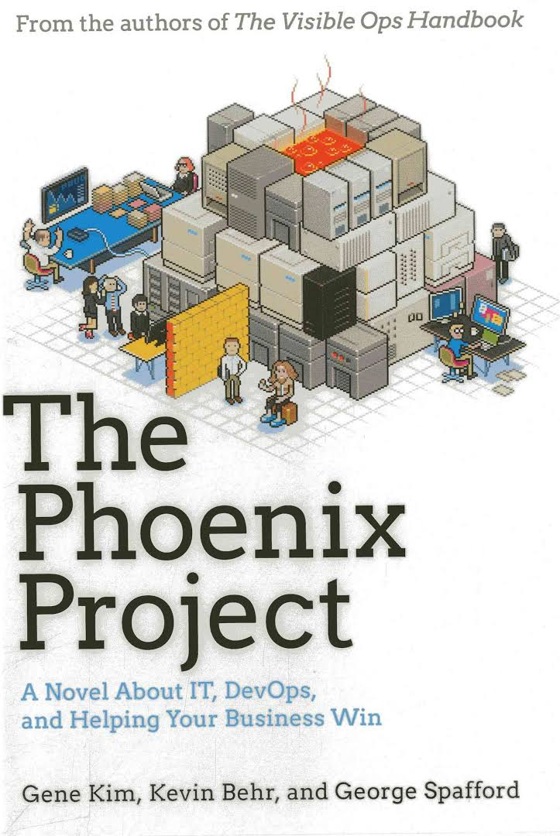
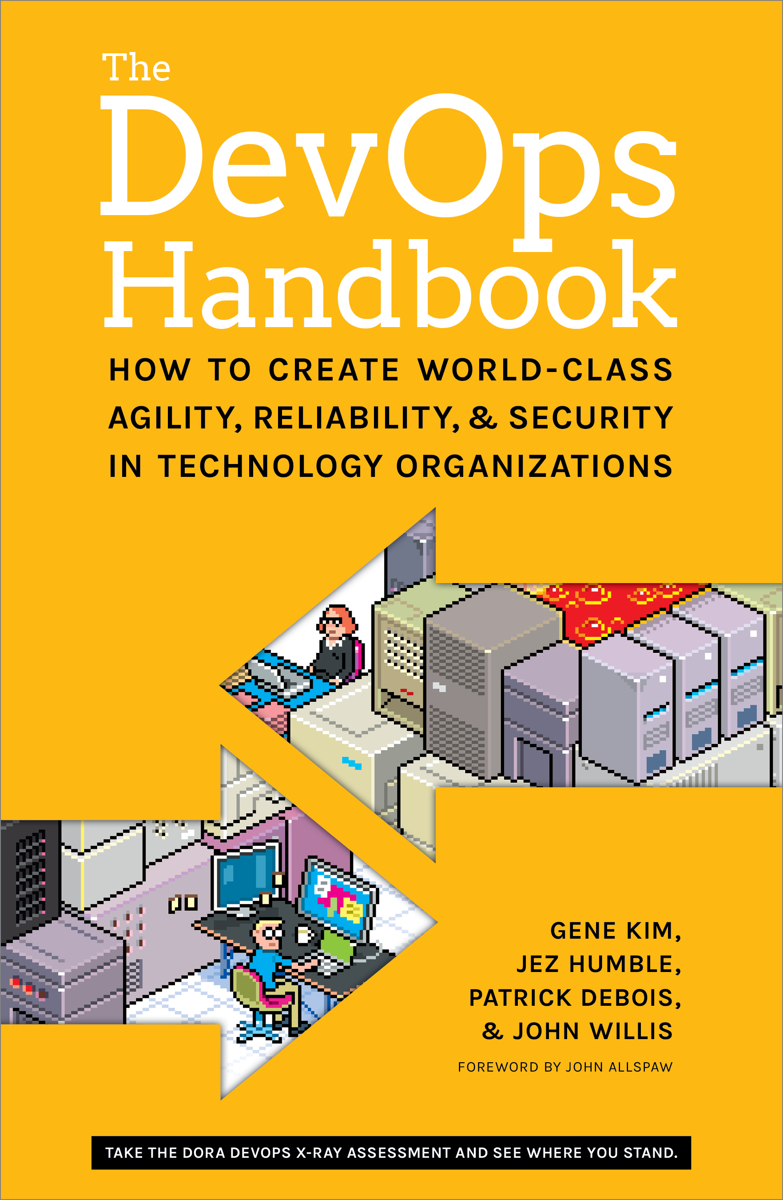
Resources
Slides
github.com/PSConfEU/2017
Whitepaper: The Release Pipeline Model
https://msdn.microsoft.com/en-us/powershell/dsc/whitepapers
Books: The Phoenix Project, The DevOps Handbook
More: http://stevenmurawski.com/devops-reading-list/

Slide 15
About_Author
Øyvind Kallstad
Senior Consultant at Crayon
Cloud and Datacenter Management MVP
oyvind.kallstad@crayon.com
@OKallstad
Jan Egil Ring
Lead Architect, Infrastructure at Crayon
Cloud and Datacenter Management MVP
Member of the editorial board of PowerShellMagazine.com
jan.egil.ring@crayon.com
@JanEgilRing

